Slide 1
Health Insurance
Cost Prediction & Analysis

Slide 2
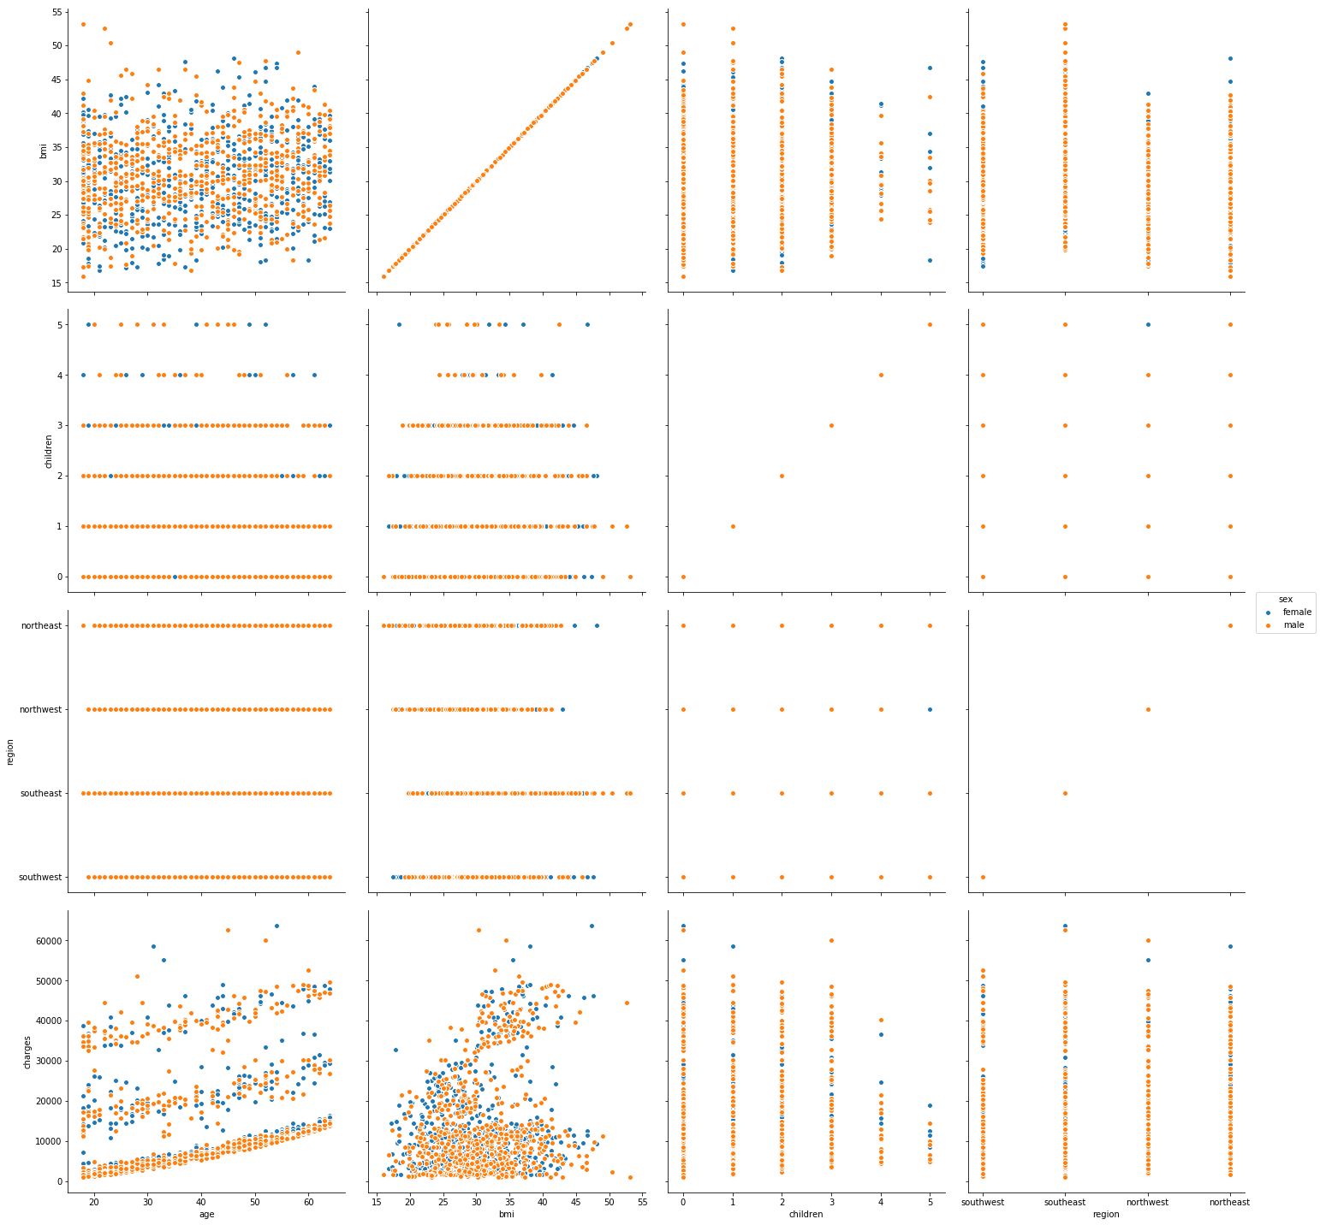
Analysis based on Sex

Slide 3
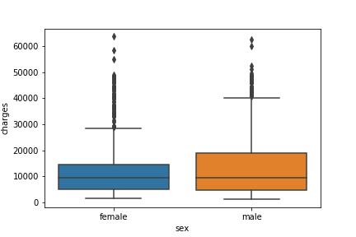
Median charges are similar for both the genders.
Sex of the applicant does not affect the charges.

Slide 4
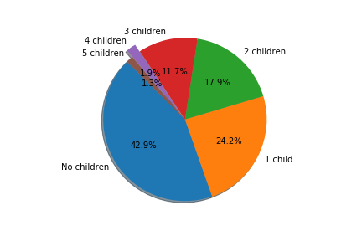
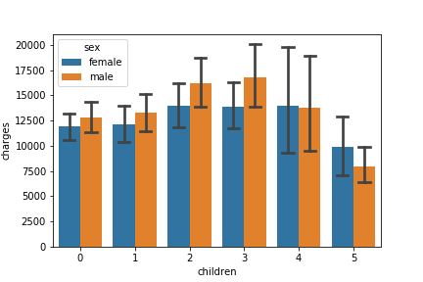
Analysis based on No. of Children

Slide 5
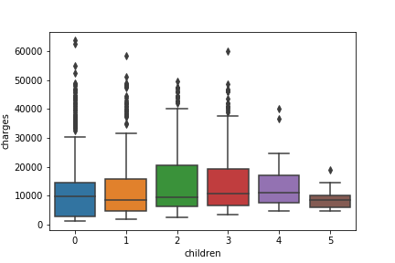
People with 5 children are found to be having lesser charges.

Slide 6
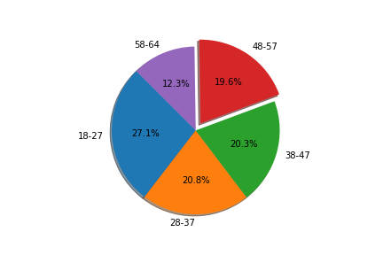
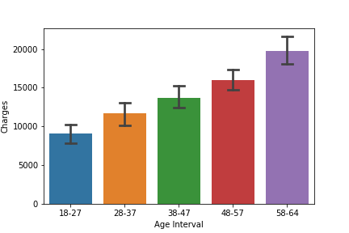
Analysis based on Age

Slide 7
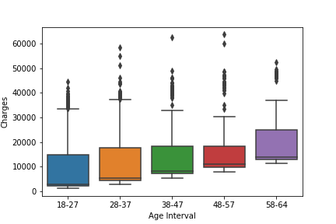
Charges increase linearly with age.
Number of applicants of the age group 18-27 are higher.

Slide 8
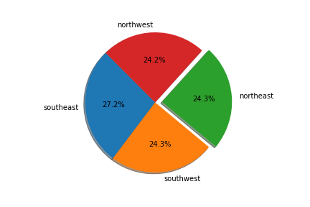
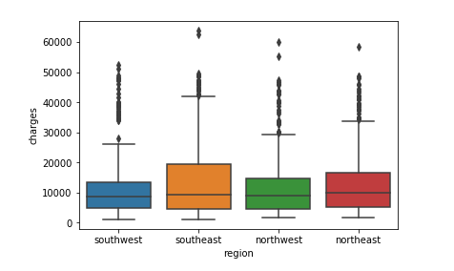
Analysis based on Region
Region has no effect on insurance charges.

Slide 9
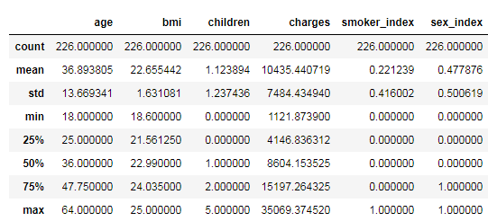
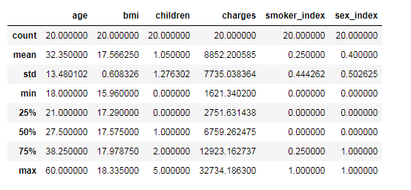
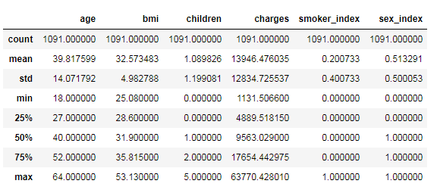
Analysis based on BMI
Good BMI
Low BMI
High BMI

Slide 10
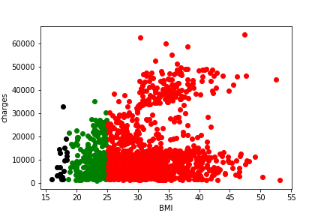
In good BMI range, the charges are directly proportional to age.
The effect of smoking doesn’t effect if the BMI is good.

Slide 11
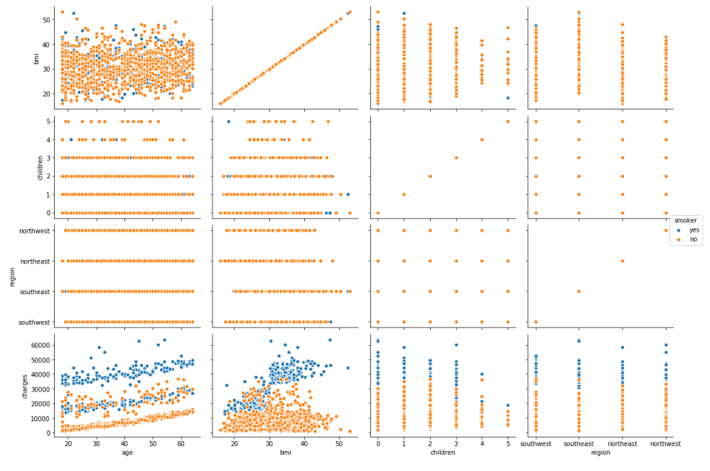
Analysis based on Smoking

Slide 12
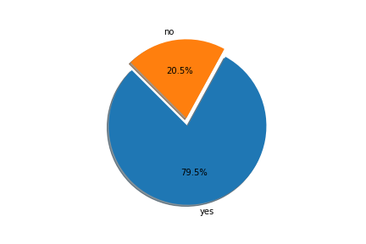
For smokers, charges are significantly higher than non smokers.
If the BMI is good, the charges are linearly linked. However, its higher than non smokers.

Slide 13
Linear Regression
Features used for Linear Regression:
Smoking
BMI
Age
Number of children

Slide 14
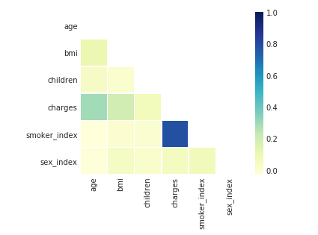
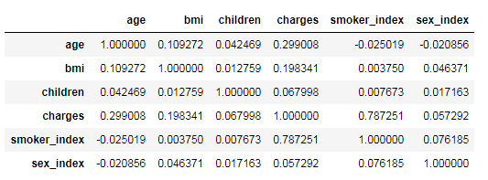
Correlation Heatmap

Slide 15
Thank You!

